Slide 2
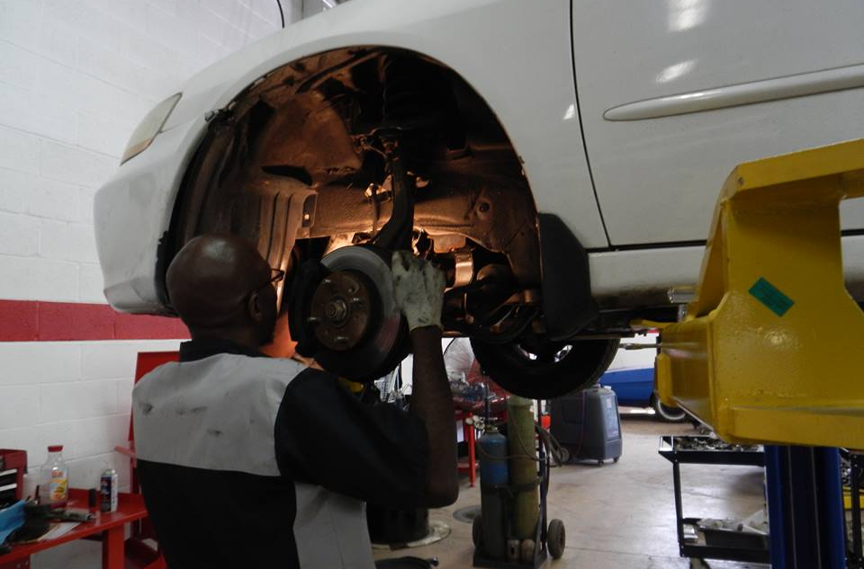
Our Vision
To create a just world where everyone has equitable access to life’s opportunities.
Our Mission
Empowers families with financial challenges to achieve economic and personal independence through car ownership and technical training.

Slide 3
The Need
Transportation
Since our launch, transportation has been identified in multiple studies as the number one barrier to employment for families living in poverty. In the Baltimore region alone, there are more than 60,000 low-income households without a car and without access to public transportation to get to a job. (Brookings Institute).
There are thousands of well-paying jobs that could be available to these individuals if they had access to reliable transportation.
Incarceration
The US incarcerates more individuals than any nation in the world. The national recidivism rate exceeds 60%. Most individuals released have no employable skills, no support system and little hope that life will be different than pre-incarceration.
There are currently more than 5,000 openings for auto technicians in Maryland.

Slide 4
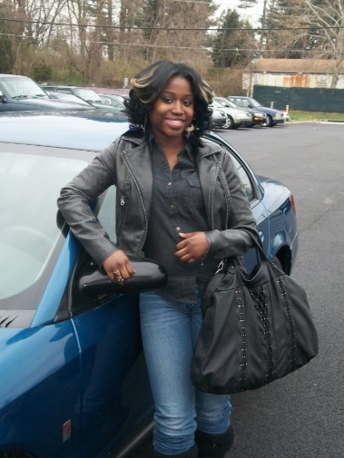
How It Works
Cars are donated by the general public
Repairs are made by certified mechanics and interns most of who were previously incarcerated.
The Recipients
A typical recipient is a single mother with two or three children
Recipients are identified by partner organizations
Recipients must meet certain requirements
Low income
Employed or with verifiable job offer
Pay $950
Recipients receive a guaranteed VFC 12-month loan and a 6-month/6,000 mile warranty
Loan helps recipients establish a credit rating

Slide 5
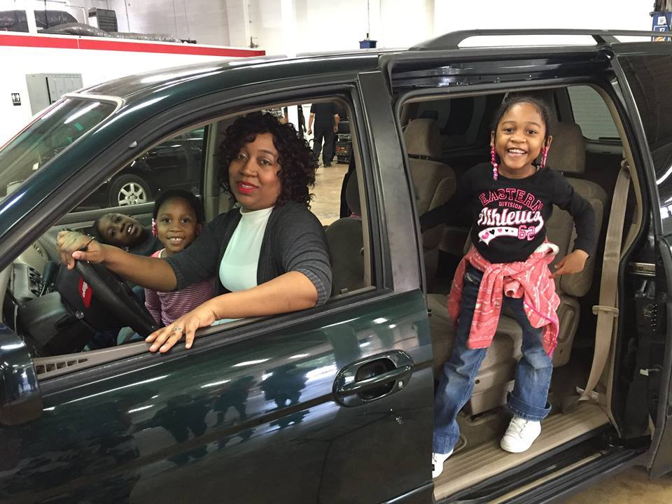
Awarding Cars to Low-Income Families
Twice as many welfare recipients with cars were working than those without cars (Brookings Institute)
VFC Results
Awarded almost 8,000 cars to worthy families since 1999 in Maryland, Virginia, and Michigan
The largest low-income car ownership program in the country
Considered a best practice program
Recently selected as the “Nonprofit of the Year” by Chesapeake Charities in MD.
VFC Impact
75% gain or attain a better job with an average salary increase of $7,000
90% of the recipient’s children attend after-school, recreational, and athletic activities
Parents spend an average of 60 minutes more at home with their children
Even improves nutrition by providing access to fresh, healthy produce for those that live in food deserts

Slide 6
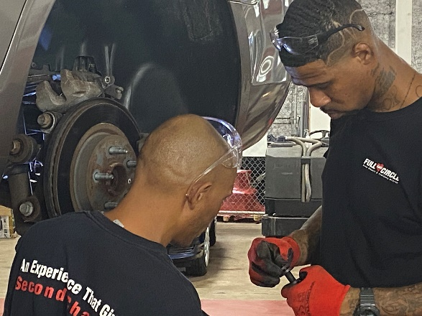
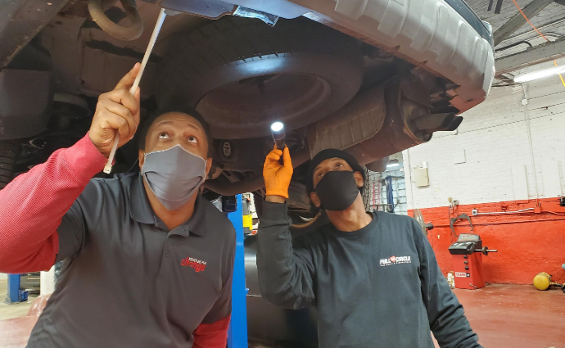
Full Circle Auto Repair and Training Program
First Graduating Class March 2016
Interns paid $9.00 to $11.50/hr.
4-months Training
Most gain 3-5 ASE Student Certifications
Help obtain a driver’s license, automotive tools, and a vehicle
Full wrap-around services provided by in-house case mngt.
Interview preparation
Follow-up and job retention

Slide 7
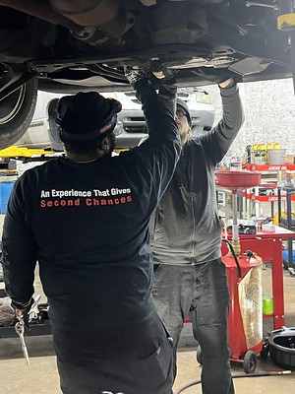
Outcomes
210 interns trained and placed since 2016
Currently training and placing 120 per year in 3 locations
90% completion; 95% placement; 94% retention
85% enter the program directly from incarceration
<5% recidivism!!!
Average starting pay $40,000
3 - 5 ASE student certifications per intern

Slide 8
VFC and Maryland
Financial Support
Earn Program
ARPA Funding – Baltimore City and Salisbury
DHS Funding for 100 Car Awards
WIOA
SNAP E&T
Other Supports (previous administration)
Car Donations from Fleet Retirement
Car Repairs (DGS and DPSCS)

Slide 9
Partners
Employment Partners
Mile one Auto Group
Cox | Manheim
Pohanka of Salisbury
Bob Davidson Ford Lincoln
Mobile Auto Service LLC
Top Gear Auto Shop
Exclusive Motors
Monroe || Mr. Tire
Other Partners
National Auto Dealers Assoc.
Napa Auto Parts
AAA
Mazda
General Motors

Slide 10
VFC – Virtual Training

Slide 11
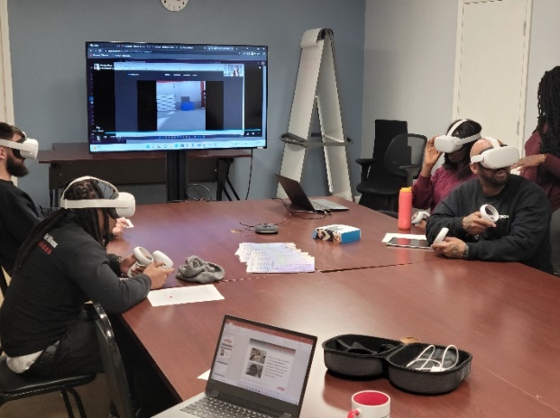
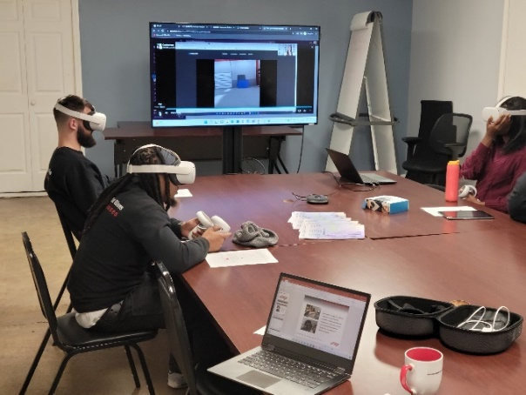
VFC – Virtual Reality
“Vehicles for Change is the most innovative, community-based auto training program in America.” National Auto Dealers Assoc.
The purpose of the VR Training is twofold
Reduce the training time and increase the number of graduates in the VFC training program
Create a social enterprise that will generate the funds to expand the VFC program nationally thru sales to high schools, prisons, community colleges and workforce programs.
https://www.youtube.com/watch?v=jhP-fXWflmk

Slide 12
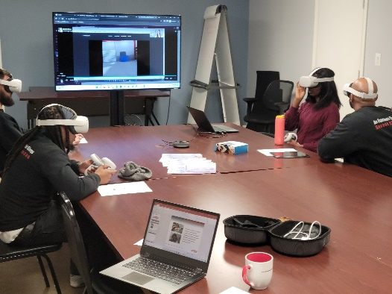
VFC – Virtual Reality
VFC has developed an entry-level virtual reality auto mechanic training module. Our partner, HTX Labs, is the leader in the industry and has produced several training modules for the USAF.
Current System
How to use an auto lift
How to complete an oil change
How to replace a set of brakes
How to remove and replace a tire
How to use tire changing and tire balancing machines
What’s Next
6 to 12 months:
Steering and Suspension
Transmission Replacement
Fluid Replacements/Flushes
12 to 18 months:
Electric Vehicles

Slide 13
VFC – Virtual Reality
The training is conducted in 5 stages:
Stage 1 – Actual video of the process in a real garage
Stage 2 – Virtual video of the process
Stage 3– A quiz is completed at the end of the 4th stage and graded by the program
Stage 4 – Student assisted practice – each step of the process is assisted- the appropriate tool to use is highlighted in the virtual garage
Stage 5 – Student completes the process unassisted. Analytics for this stage are provided by the program based on the efficiency of how well the student completed the process
All analytics are provided to the class instructor/moderator

